Slide 1
Updates: DOT Physicals and Compliance
What’s New?
Pam Matheny
Transportation Department
Public Utilities Commission
State of Ohio
Notes:
Office of Medical Programs promotes the safety of America’s roadways through the medical regulations to ensure commercial motor vehicle drivers engaged in interstate commerce are physically qualified to do so.

Slide 2
Agenda
Overview of the Commercial Motor Carrier Industry and FMCSA Medical Programs
National Registry of Certified Medical Examiners
Medical Exemptions and Variances
OSA
Online tools

Slide 3
Overview of the Commercial Motor Carrier Industry and FMCSA Medical Programs

Slide 4

Truck and Bus Driver Statistics
4 million active interstate drivers
Approx. 535,000 active interstate companies (2011)

Slide 5
Federal Motor Carrier Safety Administration Regulations
Regulate interstate commerce:
  Motor carriers
  Truck and bus drivers
  Trucks and buses
Do not regulate interstate – school bus drivers not under our jurisdiction
Federal, state, county and city employees are excepted from FMCSA regulations

Slide 6
Interstate or Intrastate
Defined by transportation of goods:
Interstate commerce, transports people or goods across a state line
  Example -- Federal Express driver
Intrastate commerce, transports people or goods within the state
  Example -- A gravel truck driver -- gravel from a quarry within a state to businesses in the same state

Slide 7
U.S. Department of Transportation (DOT)
Interstate Traffic Crash Statistics 2010
Persons | Large Truck Crashes | Bus Crashes | Large Truck and Bus Crashes | All Vehicle Crashes
Fatalities | 3,675 | 276 | 3,944 | 32,885
Injuries | 80,000 | 27,000 | 106,000 | 2,239,000

Slide 8
Medical Program Activities
Rulemaking/Guidance Development
Research
  Medical Review Board
  Medical Expert Panels
  Evidence Reports
Compliance Assistance
Medical Exemptions/Variances
  Vision, Diabetes, Hearing, Seizure
  Skill Performance Evaluation (SPE)
  Agency has requested public comment on exemption applications for seizure conditions and hearing loss

Slide 9
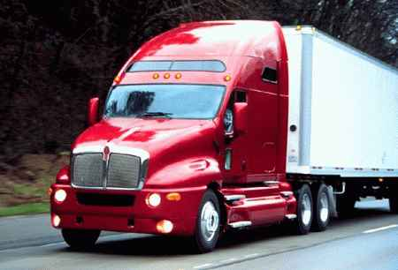
Purpose of the Medical Certification
Examination
“The purpose of this examination is to determine a driver's physical qualification to operate a commercial motor vehicle (CMV) in interstate commerce according to the requirements in 49 CFR 391.41-49.” *
* Medical Examination Report

Slide 10
What is changing?
State driver licensing agencies (SDLAs) will be adding your medical certification status and the information on your medical examiner’s certificate to your Commercial driver’s license system (CDLIS) record

Slide 11
When does this change start?
This change starts on January 30, 2012.

Slide 12
What is not changing?
The driver physical qualification requirements are not changing.

Slide 13
What must I do to comply with the new requirements for making my medical certification part of my CDL driving record?
Starting on January 30, 2012, when you:
Apply for a CDL;
Renew a CDL;
Apply for a higher class of CDL;
Apply for a new endorsement on a CDL; or
Transfer a CDL from another State

Slide 14
You will be required to self certify to a single type of commercial operation on your driver license application form. Based on that self certification, you may need to provide your SDLA (State Driver’s License Agencies) with a current medical examiner’s certificate and show any variance you may have to obtain of keep your CDL.

Slide 15
How do I determine which type of commercial motor vehicle (CMV) operation I should self-certify to my SDLA?
Determine if you are in interstate or intrastate commerce.
If you are unsure, this can be a personal follow-up question following this presentation.

Slide 16
What if I am an existing CDL holder who does not have a license renewal, upgrade or transfer between 1/30/12 and 1/30/14?
You are responsible to determine the type of commerce you are involved in and provide your SDLA with your self-certification of operating status and if required you must provide your SDLA with your current medical examiner’s certificate and any variance document.

Slide 17
After I provide my SDLA with my unexpired medical examiner’s certificate, do I still have to carry an original or copy of my medical examiner’s certificate?
Yes. Until the program is fully implemented on 1/30/14, you will still have to carry an original or copy of the medical examiner’s certificate and provide a copy to your employer for your driver qualification file.

Slide 18
What should I do with the medical examiner’s certificate beginning on January 30, 2014?
After you provide your SDLA and your employer with the medical examiner’s certificate, the medical examiner’s certificate will only be valid for the first 15 days after it was issued. Your medical examiner’s certificate will be recorded on your driving record and will become the valid version of your medical certification.

Slide 19
What if I do not provide my SDLA with my self-certification and if required, my medical examiner’s certificate and any required variance document by January 30, 2014?
Your SDLA will notify you that you are no longer medically certified to operate a CMV in non-excepted Interstate commerce. The SDLA will them remove all your CDL privileges from your license.

Slide 20
What should I do when my medical certificate and/or variance is about to expire?
You must have a new medical examination and obtain a new medical certificate. You must then provide the SDLA the new medical examiner’s certificate. You are also responsible for applying to FMCSA for a renewal of your variance.

Slide 21
What happens if my medical examiner’s certificate or variance expires before I provide my SDLA with a new one?
Your SDLA will notify you that you are no longer medically certified to operate a CMV in non-excepted Interstate commerce. The SDLA will then remove all your CDL privileges from your license.

Slide 22
How can I get back my CDL privileges?
If the medical examiner’s certificate has expired, you must obtain a new one and provide it to your SDLA. If the variance has expired, you must renew it with FMCSA. Your State may require retesting and additional fees to get back your CDL privileges. If allowed by your SDLA, you may also change your self-certification to an operating category that does not require a medical certification.

Slide 23
Who are the Medical Examiners (MEs)?
Medical examiners are:
  Medical professionals who make medical determinations based on FMCSA regulations and guidance
  Licensed, certified, and/or registered in their State
Includes, but not limited to:
  Doctors of Medicine and Osteopathy
  Physician Assistants
  Advanced Practice Nurses
  Chiropractors

Slide 24
Medical Examiner Responsibilities
Knowledgeable about:
  Physical and mental demands of CMV driver job duties
  FMCSA regulations, including guidance
Use of medical protocols
Make medical determinations based on FMCSA regulations and advisory criteria

Slide 25

National Registry of Certified Medical Examiners

Slide 26
National Registry Background
    New regulation - Published April 20, 2012
    Requires medical examiners:
  Complete training
  Pass a test
  Periodic training and testing
  Maintain licensure
Compliance Date – May 21, 2014
  All MEs must be listed on the National Registry
  All CMV drivers must use a ME on the National Registry
  Medical certificates issued prior to May 21, 2014 are valid until the expiration date

Slide 27
Medical Exemptions and Variances

Slide 28
Medical Exemptions and Variances
For interstate drivers; intrastate drivers must contact their State Driver’s Licensing Agency (SDLAs)
Application for exemption to the regulation
49 CFR 381 Exemptions
Application for a Skill Performance Evaluation (SPE)
49 CFR 391.49(b)(i)(ii) Alternative physical qualification, standards for the loss or impairment of limbs

Slide 29
Exemptions
49 CFR 381.300(a) provides:
Regulatory relief for up to 2 years
  Diabetes, Vision, Hearing, Seizure
May be renewed
May be revoked
Terms and conditions:
  Achieves a level of safety that is equivalent to, or greater than the level that would be achieved absent such exemption.

Slide 30
Federal Diabetes Exemption Program
Exemptions for drivers who have insulin-dependent diabetes mellitus
Drivers submit application
  Medical information showing their diabetes is under control
  To maintain exemption, drivers submit quarterly monitoring reports
  Diabetes exemption application can be found at:
    https://www.fmcsa.dot.gov/rules-regulations/topics/medical/exemptions.htm or call (703) 448-3094

Slide 31
Federal Vision Exemption Program
One eye does not meet the minimum vision requirements
Better eye must meet the minimum vision standard
Drivers submit application
  Medical information showing driver is able to meet all other physical requirements
  Experience driving with vision deficiency
  Crash/violation history
  Vision exemption application can be found at
    https://www.fmcsa.dot.gov/rules-regulations/topics/medical/exemptions.htm or call (703) 448-3094

Slide 32
Federal Hearing Exemption Program
Driver must perceive forced whisper in better ear at not less than 5 feet with or without hearing aid or no hearing loss in better in greater than 40 decibels at 500, 1,000 and 2,000 Hz with or without hearing aid
Driver may apply for an exemption by contacting the Medical Programs Division at FMCSA (202) 366-4001

Slide 33
Federal Seizure Exemption Program
Disqualified from operating in interstate commerce
49 CFR 391.41(b)(8)
May be considered for exemption based on number of years:
  Since last seizure, stable on anti-seizure medication, medical history
Exemption determinations are based on a case-by-case review
Driver may apply for an exemption by contacting the Medical Programs Division at FMCSA (202) 366-4001

Slide 34
Statistics
Diabetes Exemptions
  Currently 1655 exemptions
Vision Exemptions
  Currently 1967 exemptions
Hearing Exemptions
  Currently 40 exemptions
Seizure Exemptions
  Currently 22 exemptions

Slide 35
Skill Performance Evaluation (SPE)
Driver with loss or fixed limb impairment
Evaluation of driving skills
Driver completes application process including
  Assessment and evaluation by an Orthopedic Surgeon or Physiatrist
  Medical examination certification that designates he is otherwise qualified except for completion of the SPE

Slide 36
Obstructive Sleep Apnea (OSA)

Slide 37
Untreated OSA
12 – 20 million Americans suffer from OSA and 85% go undiagnosed
Untreated Impacts:
  Overall health
  Ability to obtain adequate rest
    Can lead to fatigue-related crashes
  Greater risk for other serious near and long-term medical conditions
    Coronary heart disease
    Hypertension
    Stroke
    New discoveries of negative impact on health

Slide 38
OSA
Normally, muscles of the upper part of the throat help keep the airway open
Relaxation of these muscles can cause the airway to close completely and become obstructed
Loud snoring and labored breathing occur
Breathing can stop for short periods of time (often more than 10 seconds) = sleep apnea

Slide 39
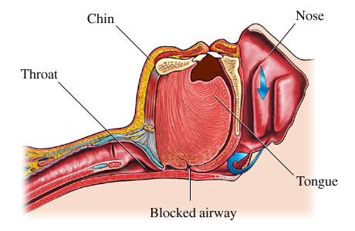
Sleep Apnea

Slide 40

Sleep Apnea Patterns
Snoring:
  Begins heavily right after falling asleep
  Continues at a regular pace, becoming louder
  Interrupted by a long silent period when there is not breathing
  Followed by a series of loud snorts and gasps
  Snoring returns
Pattern repeats itself, resulting in:
  Poor sleep quality
  Daytime drowsiness
  Headaches

Slide 41

More Sleep Apnea Signs/Symptoms
Memory difficulties
Morning headaches
Personality changes
Poor concentration
Restless sleep

Slide 42
Risk Factors You Can’t Control
Family History
Anatomy
  Narrow airways
  Large tongue with normal or small mandible
  Nasal obstruction - deviated septum, Large turbinates
  Neck Circumference
Age 65 Years and Older
High Blood Pressure

Slide 43
Risk Factors You Can Control
Weight
  Overweight/obese
  Recent weight gain
  Neck Circumference
Medications
  Use of Sedatives & Tranquilizers
Smoking
Alcohol Use

Slide 44
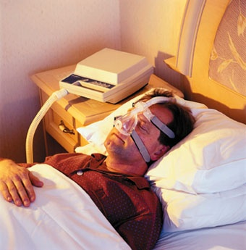
Sleep Disorders: Treatment/Devices
Treatment Options
Lifestyle changes
Mouthpieces
Breathing devices
Surgery

Slide 45

Untreated OSA - Complications
Possible complications may include:
  Abnormal heart rhythm (arrhythmia)
  Excessive carbon dioxide levels in the blood
  Heart disease
  High blood pressure
  Sleep deprivation
  Stroke

Slide 46
So what’s the problem?
  28% CMV drivers have mild or higher levels of OSA*
      5.8% - moderate OSA 4.7% - severe OSA
Discovering OSA
  Important for both driver health and road safety
OSA can be treated and safely managed with cost-effective programs
  Screen, Diagnose, Treat, Track
Drivers don’t have to be taken off the road

Slide 47
Online Tools

Slide 48
Online Tools
You may access the following on the the FMCSA website:
  Evidence Reports
  Medical Expert Panel Reports
  Medical Review Board (MRB) Recommendations
  Medical Examiner’s Handbook

Slide 49
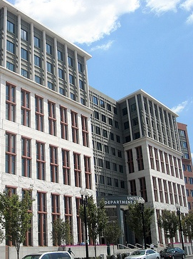
Contact Information
Federal Motor Carrier Safety
Administration, Medical Programs Division
U.S. Department of Transportation
Washington, D.C.
E-mail: fmcsamedical@dot.gov
Phone: (202) 366-4001
Fax: (202) 366-8842
Medical Programs
www.fmcsa.dot.gov/rules-regulations/topics/medical/medical.htm
National Registry Website
www.nationalregistry.fmcsa.dot.gov

Slide 50
Summary
Overview of the Commercial Motor Carrier Industry and FMCSA Medical Programs
National Registry of Certified Medical Examiners
Medical Exemptions and Variances
OSA
Online tools

